Slide 1
Eliminate the Wait
Faster Builds and Tests with Electric Accelerator
Steve Bower, IT Solutions Architect, Cisco Systems
sbower@cisco.com
October 20, 2015

Slide 2

Do You Remember…
Vaxes™! (Vaxen?)
Ultrix™!

Slide 3
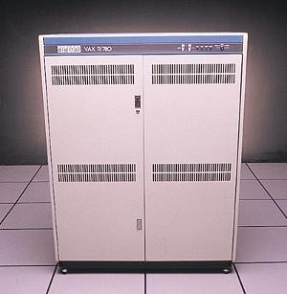
A Big Environment
Five of them!

Slide 4

Systems Administration
Touch each one
(remember rlogin?)

Slide 5
Start Automating
Let’s use rsh
#!/bin/sh
HOSTS=“vax1 vax2 vax3 vax5”
for h in $HOSTS ; do
echo Running on $h
rsh $h “$@”
done

Slide 6
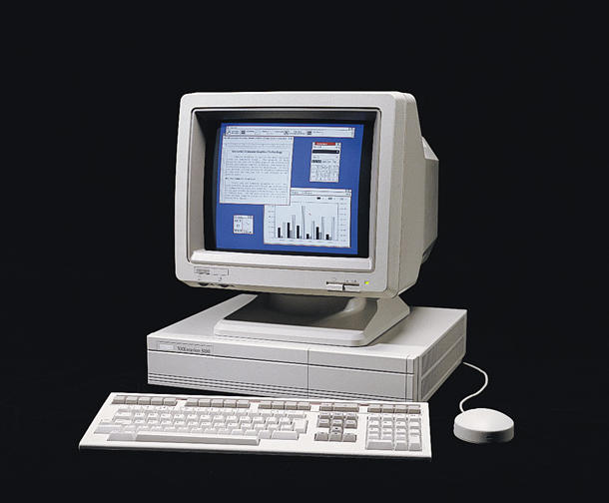
Then what?
VAXstations™…
DECstations™…

Slide 7
Parallelize!
mrsh – “Multiple” rsh
mrsh
rsh host1 command
rsh host2 command
rsh host3 command

Slide 8
For example…
mrsh vax1,vax2,vax3,vax5 uptime
mrsh ./hostlist grep ERROR /var/adm/syslog
Also: mrcp
mrcp ./hostlist /etc/hosts.equiv /etc

Slide 9
More growth
Dozens of systems
A couple hundred systems
Notes:
4 at a time
up to 10 at a time

Slide 10
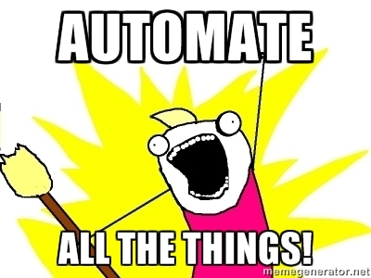


Slide 11
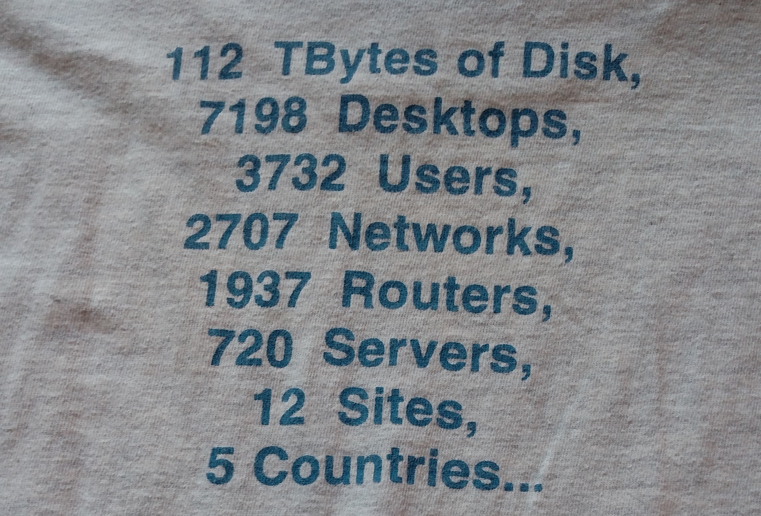
Welcome to Cisco
Notes:
Circa 2000?

Slide 12
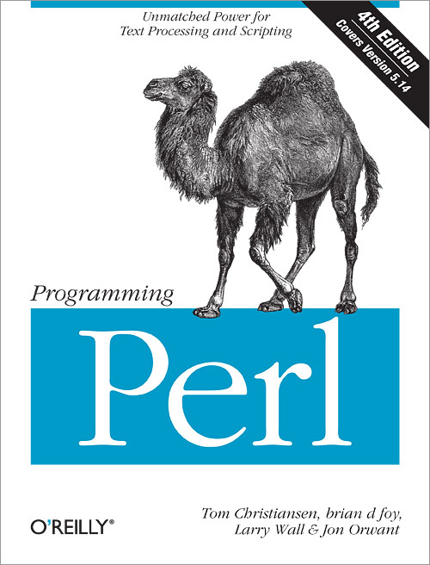
Re-implement
mrsh, mrcp
Now in Perl

Slide 13
More Growth…
Systems | Parallelism
1,000 | 20-50
7,500 | 100-300
20,000 | 1000+
Notes:
In there: mssh, mscp

Slide 14
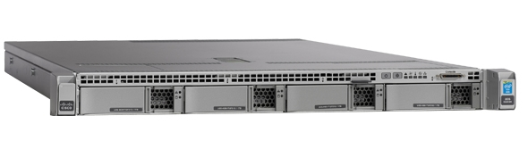
Linux Development Service
From Sun servers
to Linux
Notes:
still shared, local disk

Slide 15
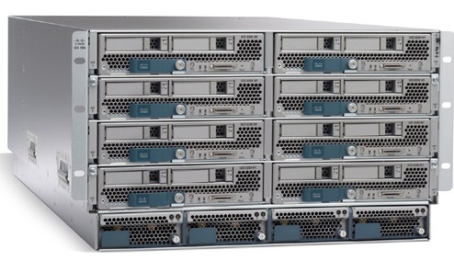
Moving to Virtual Machines
Aurora Project
Fuels the growth!

Slide 16
Aurora Features
On-demand development VMs
Automatic integration
Flexible storage (/nobackup)
Notes:
RHEL OS
Automount, join AD, set up for user

Slide 17


Aurora Service Architecture
Start Developing
Virtual
Development
System
Request
System
Cisco
Workplace
Portal Web UI
Cisco Orchestration
Management
Cisco Unified Computing System
(UCS) Virtual Infrastructure
Config
Mgmt
db
Storage

Slide 18
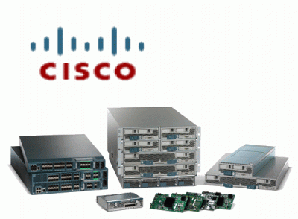
Aurora Development Service Locations
Americas (5)
Boxborough
San Jose
RTP
Richardson
Kanata / Ottawa
EMEA (1)
Reading / Greenpark
APAC (1)
Bangalore
Caveat: directional; use for guidance only; 30% error margin on cost
Non-Aurora DC
Aurora DC

Slide 19

Aurora Benefits
Flexible environment
Increased density
Reduced footprint
Faster performance
Notes:
Performance?

Slide 20

VM Performance
Need for speed…

Slide 21
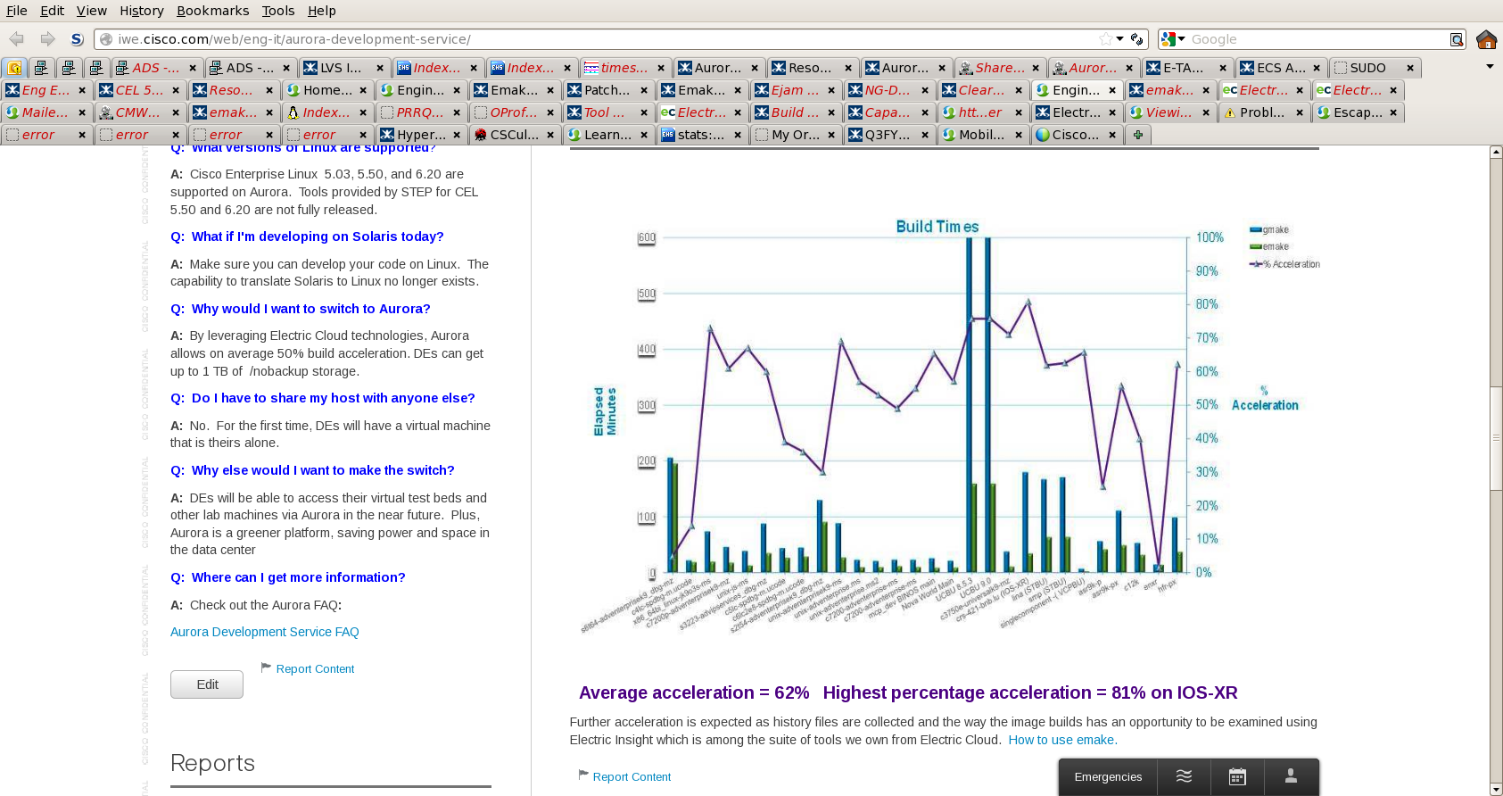
Emake build times

Slide 22
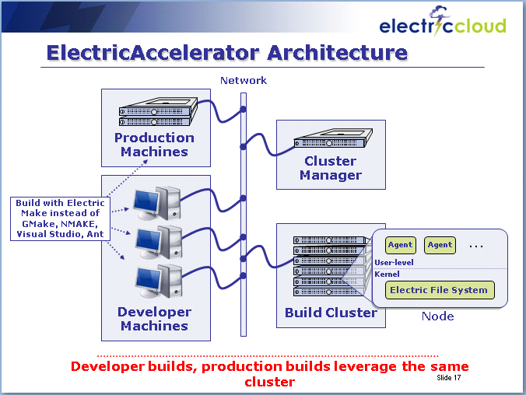
Emake’s Little Brother
electrify

Slide 23
Use case
mrsh -> mssh -> mdo
mdo –c8 big* -- gzip
echo big* | xargs –n1 –P8 gzip
mdo
gzip
gzip
gzip
Notes:
data packrat

Slide 24
Adding Electrify
electrify
--electrify-remote=gzip
sh –c “mdo –c32 big* -- gzip”

Slide 25
How it looks…
Build Cloud Node
gzip
gzip
electrify
mdo
Build Cloud Node
gzip
gzip

Slide 26
Adding Electrify_proxy
electrify
--emake-electrify=none
sh –c “mdo –c32 big* -- electrify_proxy gzip”

Slide 27
How it looks with electrify_proxy
Build Cloud Node
electrify_proxy
gzip
gzip
electrify
mdo
electrify_proxy
Build Cloud Node
electrify_proxy
gzip
electrify_proxy
gzip

Slide 28
How it really looks (DANGER!)
Build Cloud Node
electrify
gzip
3
2
gzip
mdo
electrify_proxy
Build Cloud Node
1
gzip
gzip

Slide 29
Real-world Case 1
Firmware analysis
200 checks
Parallel but local, 2+ hours
Notes:
Jerry David, checks several seconds to 15-20 minutes

Slide 30
Use the cluster
Build Cloud Node
echeck
electrify_proxy
check
check
electrify
echeck
electrify_proxy
Build Cloud Node
electrify_proxy
check
electrify_proxy
check
Notes:
Can also use remote farm

Slide 31

Results
2+ hours -> 20 minutes

Slide 32

Future directions
500 checks
Adjustable parallelism
Notes:
Steve Johnson

Slide 33
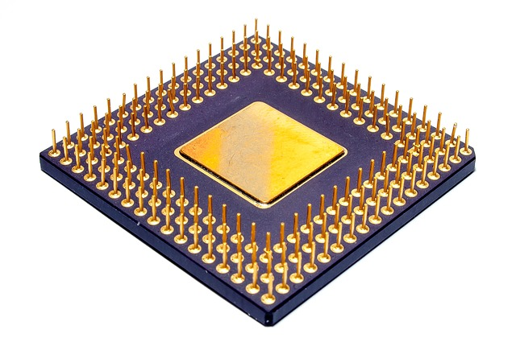
Real-world Case 2
ASIC simulation
UK

Slide 34
Results…
No new infrastructure required
$$$$

Slide 35

Real-world Case 3
IOS-XR
“Jam” build tool

Slide 36

Jam and electrify components
ejam
electrify
jam
ejam_proxy
electrify_proxy

Slide 37
ejam diagram
Build Cloud Node
ejam_proxy
electrify_proxy
job
ejam_proxy
electrify_proxy
job
ejam
electrify
jam
ejam_proxy
electrify_proxy
Build Cloud Node
job
ejam_proxy
electrify_proxy
job

Slide 38

Results…
50-60% time savings
2 - 2.5x

Slide 39
Eliminate the Wait
Faster Builds and Tests with Electric Accelerator
Steve Bower, IT Solutions Architect, Cisco Systems
sbower@cisco.com
October 20, 2015

